Slide 1

Developing Management Skills
Building Effective Teams and Teamwork

Slide 2
Learning Objectives
Diagnose and facilitate team development
Build high-performance teams
Facilitate team leadership
Foster effective team membership

Slide 3

Teams
Groups of people who are interdependent, interact with each other, and see themselves as a unique entity.

Slide 4

A Team Metaphor
Effectives teams are like geese,
They both have interdependent members
They are more efficient working together
They create their own magnetism

Slide 5
A Team Metaphor (con’t)
They do not always have the same leader
Members care for and nurture one another
They cheer for each other
They have a high level of trust

Slide 6
The Team Explosion
79% of Fortune 1000 companies use self-managed teams
91% use employee work groups
More than 2/3 of college students participate in teams

Slide 7
Team and Performance
Teams can improve performance by:
Cutting staffing costs
Reducing errors
Improving decision making
Improving employee relations

Slide 8

A Team Example
Logistical Support for the United States Armed Services in the 1990 Persian Gulf War.

Slide 9

Pagonis’ Team
122 million meals
1.3 billion gallons of fuel
Tanks, planes, ammunition, etc
500 new traffic signs in different languages
500 tons of mail each day
70,000 contracts

Slide 10

Stages of Team Development
Forming
Norming
Storming
Performing

Slide 11

Groupthink
When the preservation of the team takes precedence over good decisions and problem solving.

Slide 12




Janis’ Examples of Groupthink
Cuban Missile Crisis
Bay of Pigs

Slide 13
Symptoms of Groupthink
Illusion of invulnerability
Shared stereotypes
Rationalization
Illusion of morality
Self-censorship
Direct pressure
Mind-guarding
Illusion of unanimity

Slide 14
Resolving Groupthink
Critical evaluators
Open discussion
Subgroups
Devil’s advocate
Second-chance meetings

Slide 15
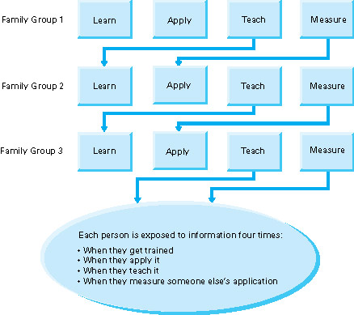
Xerox Dissemination Process
Insert figure 9.2

Slide 16
Attributes of High Performing Teams
Performance outcomes
Specific, shared purpose and vision
Mutual, internal accountability
Blurring of formal distinctions
Coordinated, shared work roles

Slide 17
Attributes of High Performing Teams
Inefficiency leading to efficiency
Extraordinarily high quality
Creative continuous improvement
High credibility and trust
Clarity of core competence

Slide 18

Leading Teams
Two critical factors:
Developing credibility and influence
Establishing a motivating vision and goals

Slide 19
Developing Credibility
Demonstrating integrity
Being clear and consistent
Creating positive energy
Building a base of agreement

Slide 20
Developing Credibility
Using one-sided and two-sided arguments appropriately
Encouraging team members to help them personally improve
Sharing information

Slide 21

Team Leadership and Goals
SMART Goals
Specific
Measurable
Aligned
Realistic
Time-bound

Slide 22
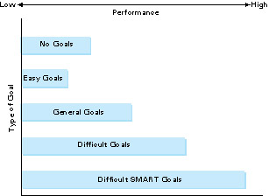
Effects of Goals on Performance
Insert figure 9.3

Slide 23

Everest Goals
Represents ultimate achievement
Clear and compelling
A unifying focal point
Builds team spirit

Slide 24
Examples of Everest Goals
Henry Ford – Affordable cars for employees
Masaru Ibuka – Sony to overcome image of Japanese quality
Steven Jobs – One computer for every person on the planet
Sam Walton – Wal-Mart to become a trillion-dollar company

Slide 25

Team Membership
Team members not only need clear goals, they needs roles to help facilitate task accomplishment and group cohesion.

Slide 26
Task Facilitating Roles
Direction giving
Information seeking
Information giving
Elaborating
Urging
Monitoring
Process analyzing
Reality testing
Enforcing
Summarizing

Slide 27
Relationship Building Roles
Supporting
Harmonizing
Tension Relieving
Confronting
Energizing
Developing
Consensus building
Empathizing

Slide 28
Blocking Roles
Dominating
Overanalyzing
Stalling
Remaining passive
Over-generalizing
Fault-finding
Premature decision making
Presenting opinions as facts
Rejecting
Pulling rank
Resisting
Deflecting

Slide 29

Feedback
Many managers are afraid of correcting bad behaviors because they don’t want to offend employees.

Slide 30
Rules for Effective Feedback
Focus on behaviors
Focus on observations
Focus on descriptions
Focus on a specific situation

Slide 31
Rules for Effective Feedback
Focus on here and now
Focus on sharing ideas and information
Give feedback that is valuable
Give feedback at an appropriate time and place

Slide 32
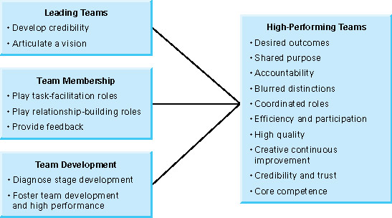
Management Skills for High Performing Teams
Insert figure 9.4

Slide 33
Behavioral Guidelines
Diagnose the stage that your group is in to facilitate team development
Provide structure in the forming stage, support in the norming stage, independence in the storming stage, and foster innovation in the performing stage

Slide 34
Behavioral Guidelines
Develop credibility as a prerequisite to leading a team
Establish SMART and Everest goals
Encourage performance of task and relationship leader roles
Confront blocking behaviors
Provide effective feedback

